Slide 1
Creative Industry
Content
Experience
Design
Technology
Advertising & Marketing
Film & Video
Music
Publishing
Radio & Podcasts
Photography
Social Media
Performing Art
Museums
Galleries
Festivals
Visual & Graphic Art
Theatre
Concerts
Heritage
Architecture
Fashion
Graphic design
Industrial design
Digital Design
Crafts
UI design
IT software computer services
Video Games
VR & AR
VFX
NFT
UX design

Slide 2
Advertisement sector

Slide 3
General overview of the sector
Ad spending in the Advertising market is projected to reach US$49.60bn in 2023.
The largest market is Search Advertising with a market volume of US$21.45bn in 2023.
In the Advertising market, 89.0% of total ad spending will be generated through digital in 2027.
In the Advertising market, 84.7% of the Digital Advertising revenue will be generated through programmatic advertising in 2027
Ad spending change by segment – 7.4%
60.07
58.09
55.42
49.60
52.60
46.17
42.27
33.15
34.36
30.43
27.49
Notes:
Steadiest and fastest growing sub-sector of advertising
Print advertisement will be shrinking with each year

Slide 4
Traditional advertising in the UK has seen a decline due to the rise of digital media and online advertising.
Television is the most popular form of traditional advertising in the UK, followed by radio, out-of-home, newspapers, and magazines.
Recent studies show that traditional advertising, particularly TV ads, can be more effective in driving sales compared to online display ads.
The digital advertising market in the UK is rapidly growing, driven by the increasing popularity of digital media platforms and mobile in-app advertising.
Key trends in the UK digital advertising market include mobile advertising, video advertising, social media advertising, and programmatic advertising.
Notes:
Fast Moving consumer goods

Slide 5
Advertising expenditure
Advertising spending in the United Kingdom in 2022 was 34.77 billion British pounds, up roughly 9% from the previous year. Ad spend in the country is expected to remain stable in 2023, increasing by 4% a year later to approximately 36.4 billion pounds.

Slide 6
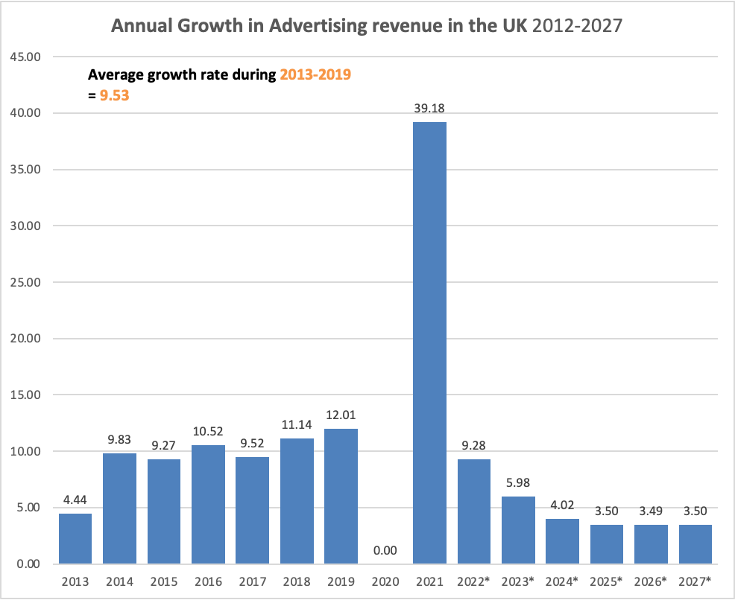
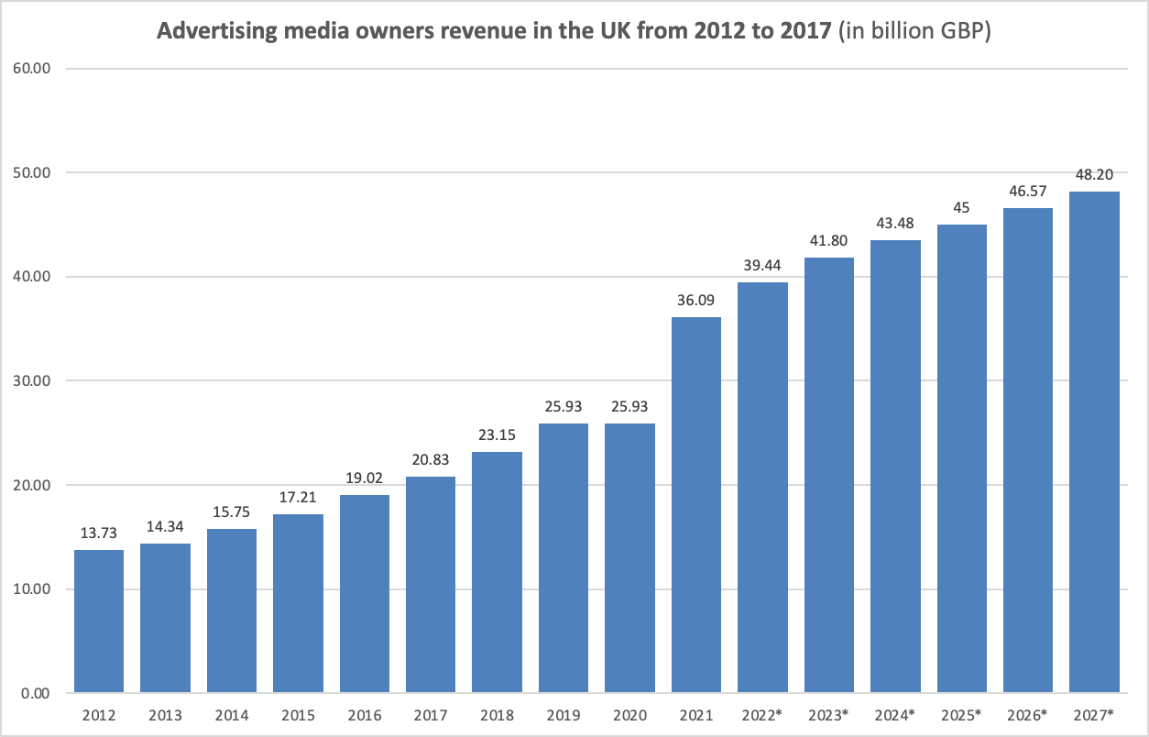
Advertising media owners revenue
Analyst assumes that average growth rates for the advertising revenue will stay at the 9 %.

Slide 7
Global comparison
Even though the United Kingdom is one of the world's leading advertising markets, the region's ad industry has been severely disrupted since the outbreak of the pandemic. Revenue growth slowed for the first time in many years as many companies reduced their budgets and reduced advertising activities in the face of current uncertainties. This fatigue subsided as early as 2021, when the industry experienced a complete financial recovery, a trend that was mirrored globally. Between 2020 and 2021, global ad revenue increased from 621 to over 772 billion US dollars, clearly exceeding pre-pandemic levels.
Notes:
Based on the latest projections, advertising spending in the United Kingdom is set to reach 39.4 billion British pounds in 2022. The source further estimated that the spending would surpass 48 billion pounds by 2027.
The UK is one of the world’s leading advertising markets , but even so, the region’s ad industry has experienced major disruptions following the onset of the pandemic. Revenue growth slowed for the first time in many years as many companies scaled down their budgets and reduced advertising activities amid the uncertainties of the time. This weariness subsided as early as 2021 when the industry made a full financial recovery – an upward trend that was also mirrored on a global scale. Between 2020 and 2021, global ad revenue jumped from 621 to over 772 billion U.S. dollars and visibly surpassed pre-pandemic levels.
Advertisers across the UK no longer place all their bets on traditional media formats as consumers gradually turn to digital channels for information, communication, and entertainment. The internet has long overtaken television as the leading advertising medium in the UK , and based on the latest data, digital ad spending reached an all-time high of around 28 billion British pounds in 2021. Television and video, for example, drew less than five billion that year. And even though there has been an uplift in spending on TV commercials in 2021, other legacy media such as print newspapers and magazines continue to attract smaller investments and brand

Slide 8
Film Industry

Slide 9
Film Industry overview
The UK film industry had a turnover of £18.8 billion in 2019.
The industry's direct contribution to GDP was £8 billion in 2019, representing 7% of the GDP of all creative industries.
The UK film industry exported £2.3 billion worth of services in 2019, with £1.7 billion in royalties and £600 million in audiovisual and related services.
The UK film trade surplus in 2019 was £1.28 billion.
Between 2016 and 2020, the number of companies in the film industry increased by 22%.
In 2020, there were over 8,600 film production companies, over 3,000 post-production companies, 405 film distributors, and 270 film exhibitors in the UK.
Film distributors accounted for 2% of companies but 47% of industry turnover.
The majority of film companies had an annual turnover of less than £250,000.
The European Union was the largest export destination for UK film, accounting for 43% of exports, followed by the USA at 24%.
The UK film industry had a positive trade balance, contributing to the UK balance of payments.
Notes:
Accroding to BFI yearbook of 2021 full report
The industry's direct contribution to GDP was £8 billion in 2019, representing 7% of the GDP of all creative industries.
The UK film industry exported £2.3 billion worth of services in 2019, with £1.7 billion in royalties and £600 million in audiovisual and related services.
The European Union was the largest export destination for UK film, accounting for 43% of exports, followed by the USA at 24%.
The UK film trade surplus in 2019 was £1.28 billion.

Slide 10
Average growth rate - 3.62

Slide 11
Annual change in video distribution and production
Average growth rate – 16.64

Slide 12
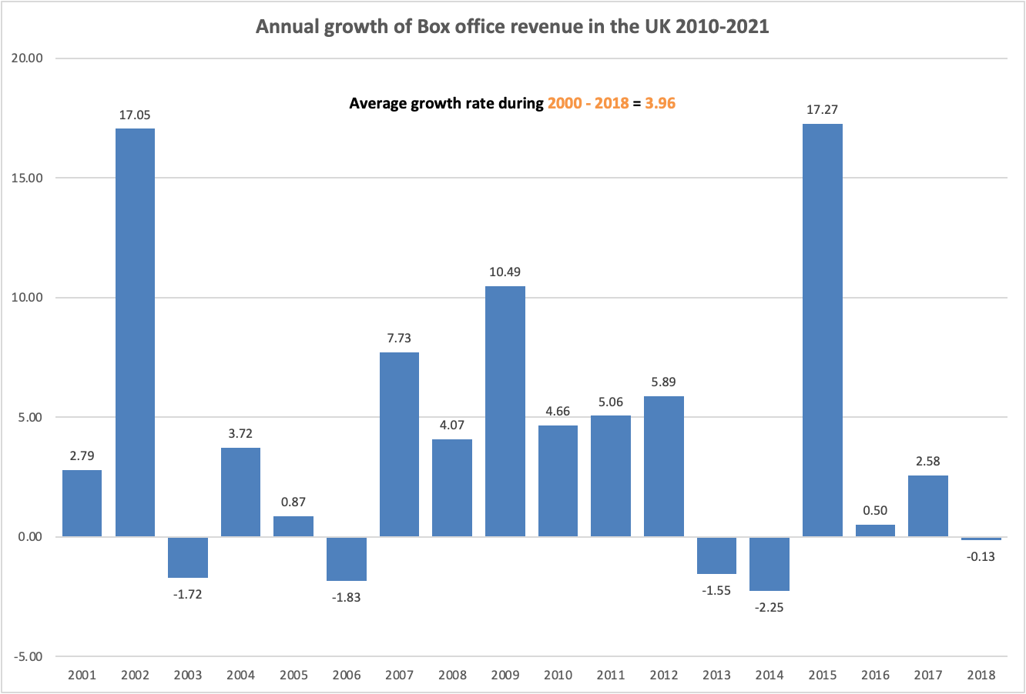
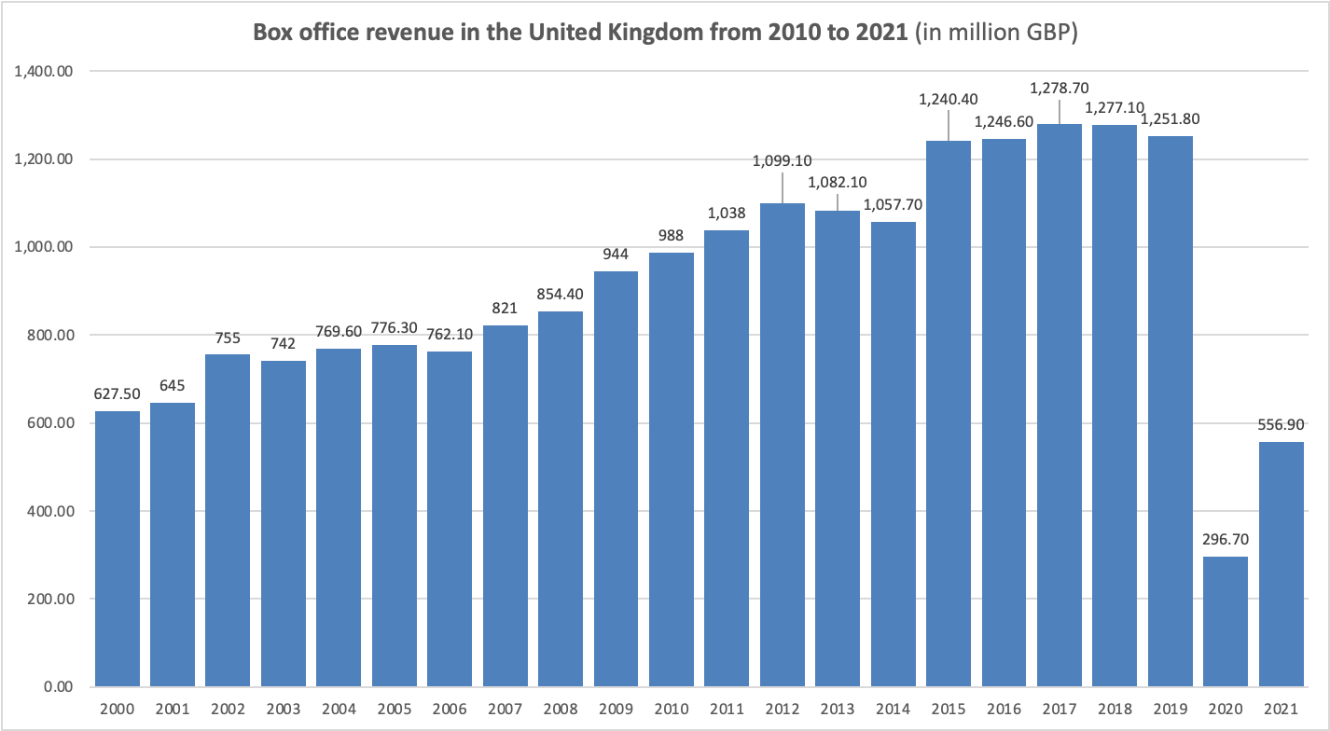
Box office revenue
Average growth rate for the period of 2001-2018 = 3.96

Slide 13
Gross revenue
In 2020, the total filmed entertainment market in the UK was worth an estimated £2.64 billion, down 24% from £3.46 billion in 2019.
Revenues from digital video were £1.35 billion, an increase of 40% from £966 million in 2019.
Digital video accounted for 51% of the total market, compared with 28% in 2019.
Gross revenues for UK film were an estimated £948 million, down from £1.25 billion in 2019.
Notes:
bfi-yeabook-2021-uk-market-as-a-whole-full-report-revised

Slide 14
Gross revenue
In 2020, the total filmed entertainment market in the UK was worth an estimated £2.64 billion, down 24% from £3.46 billion in 2019.
Revenues from digital video were £1.35 billion, an increase of 40% from £966 million in 2019.
Digital video accounted for 51% of the total market, compared with 28% in 2019.
Gross revenues for UK film were an estimated £948 million, down from £1.25 billion in 2019.
Notes:
123456

Slide 15
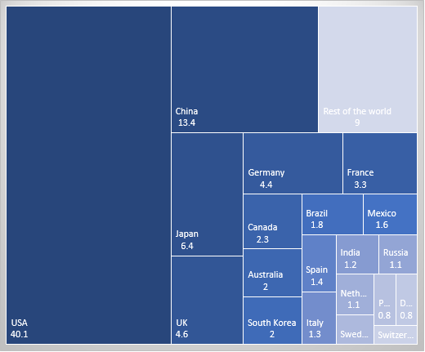
Overview of the current state of the global market

Slide 16
Expected growth Rate of the Film Industry

Slide 17
Music Industry

Slide 18
Overview of the UK’s Music Industry
UK recorded music revenue increased by 12.8% to £1.262 billion in 2021.
Average growth rate during almost 2 decade was 0.54 %
Performance rights income, from music played in public, reached £117 million.
Streaming revenues increased by 13.7% to £837.2 million and accounted for 88% of streaming revenues and 58% of total revenues.

Slide 19
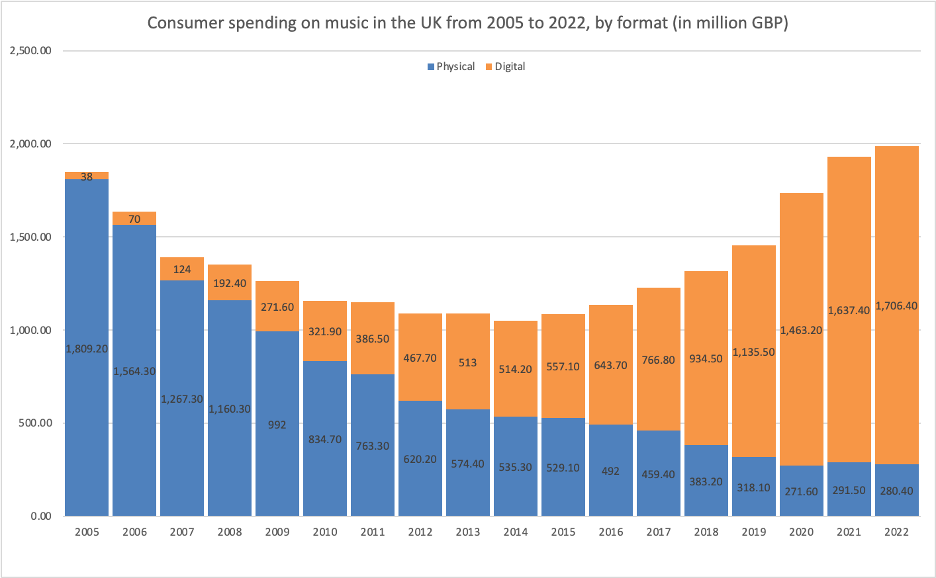
Overview of the UK’s Music Industry
Consumer spending and revenue started showing positive growth rates after digital format of music distribution became dominant
Label revenues reached their highest value since 2006 when public performance and sync figures were included.
Physical formats, particularly vinyl and CDs, grew at a faster rate of 14.6%, contributing £241 million.
Vinyl sales continue to rise and approached half of the total physical revenues.
Streaming subscriptions accounted for 88% of streaming revenues and 58% of total revenues.
Physical formats, particularly vinyl and CDs, continue to play a significant role in revenue generation.
Notes:
Physical average decline rate -10 %
Digital average growth rate 26

Slide 20
Music retail sales revenue
Total music category sales in the UK reached £1.9869 billion in 2022, a 3% increase compared to the previous year.
In-car radio remained the most popular device for accessing music, followed by Spotify and Amazon Music among under-25s.
Streaming dominated the music consumption preferences, with subscription streaming accounting for 56.1% and free streaming for 24.3%.

Slide 21
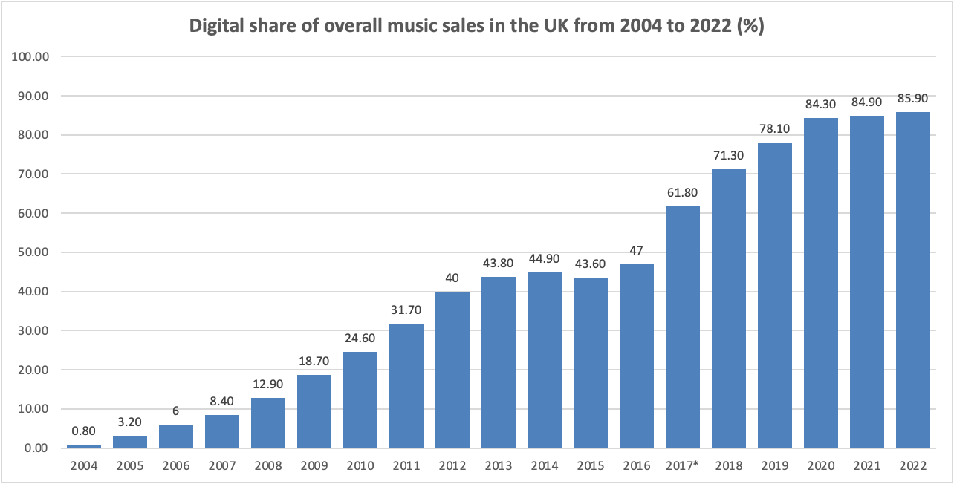
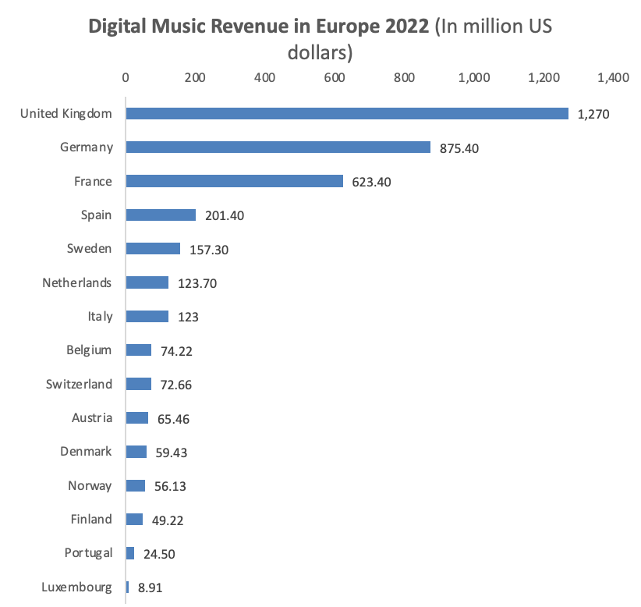
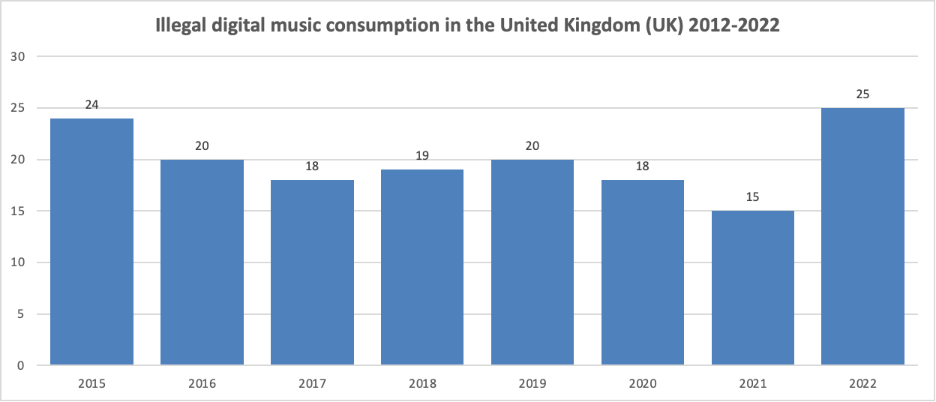
UK’s Music sector – additional information

Slide 22
Experience
Historic Sites: Overall, there is little growth or decline in the number of people visiting historic sites, except during the pandemic, which had a significant impact on visitor numbers.
Museum Revenue: Revenue from museums is steadily increasing, with occasional periods of decline, indicating a positive financial trend in the sector.
Theater Box Office Revenue: The UK theater industry shows minimal growth in box office revenue over the years, without experiencing any decline.
Live Music Industry: The live music sector is experiencing decent growth, indicating a thriving and evolving industry.
Live Music Comparison: Among other countries, the USA has a massive live music sector, making comparisons with other countries difficult. However, the UK leads the way in this sector.
Museum Revenue Comparison: The USA boasts enormous revenue from museums, making it incomparable to other countries. China holds the second position in terms of museum revenue.

Slide 23
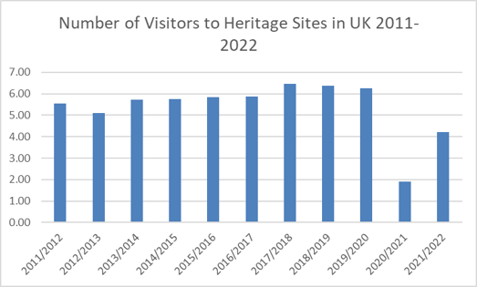
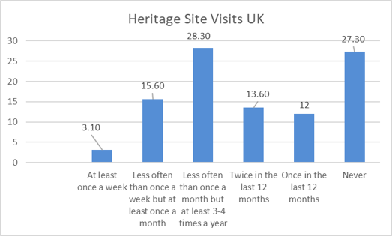
Experience – Heritage
Peak Visitation: The highest recorded number of visitors at these Heritage Sites was in 2017/2018, reaching an impressive 6.46 million individuals, demonstrating the widespread appeal and popularity of these destinations.
Challenging Times: In contrast, the lowest number of visitors occurred during 2020/2021, with only 1.90 million visitors. This significant decline was primarily attributed to the impact of lockdowns during this period, highlighting the influence of external factors on visitor numbers.
Diverse visitor patterns: 28% of adults engage multiple times a year (3-4 on average), 27% miss out on the experience, while an enthusiastic 3% immerse themselves weekly.

Slide 24
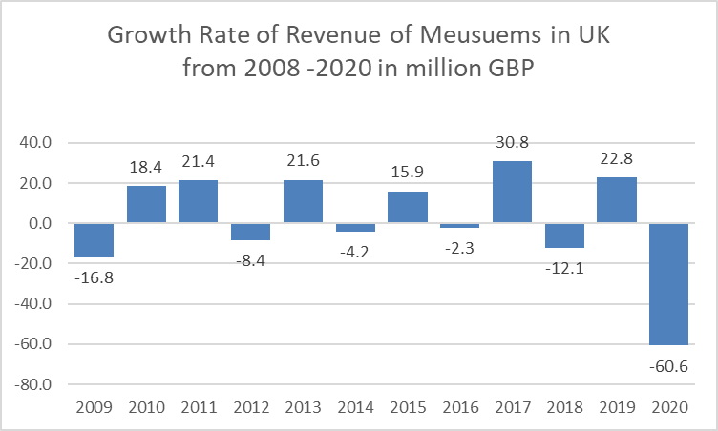
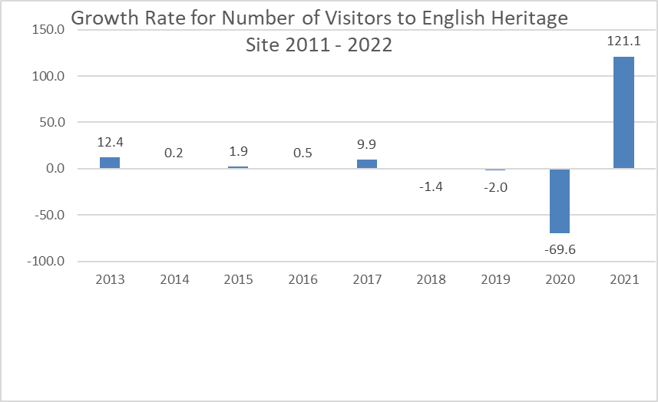
Heritage –Growth Rate
Mix of tends: Visitor patterns showcase both upward and downward trends.
Moments of growth: Years 2017 and 2019 had notable growth rates of over 30% and 22.8% respectively.
Challenging declines: 2020 experienced the highest decline of 60.6%, followed by 2009 with a decline of 16.8%.
Mix of tr
Steady trend, except for a notable surge of 9.9% in 2017/2018 and a subsequent dip to -1.4% in 2019/2020.
Dramatic declines followed, with -2% in 2019/2020 and a significant -69.6% in 2020/2021.
A remarkable rebound occurred in 2021/2022, with a staggering increase of 121.1%.

Slide 25
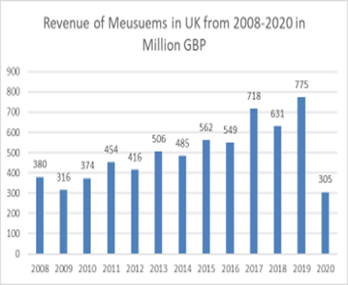
Museums
Mixed trends: Revenue patterns exhibit both upward and downward trends, creating a dynamic landscape of financial performance.
Notable growth: Years 2010, 2011, 2013, 2015, 2017, and 2019 experienced upward trends, with 2017 leading the way with over 30% growth, followed by 2019 with 22.8%.
Challenging declines: In contrast, 2020 faced the highest decline of 60.6%, closely followed by 2009 with a decline of 16.8%, reflecting the impact of external factors on revenue fluctuations.
Upward trend since 2008, indicating consistent growth.
Revenue peaks: 2019 generated the highest revenue at 775 million GBP, followed by 2017 at 718 million GBP.
Lowest revenue: 2020 recorded the lowest revenue at 305 million GBP.

Slide 26
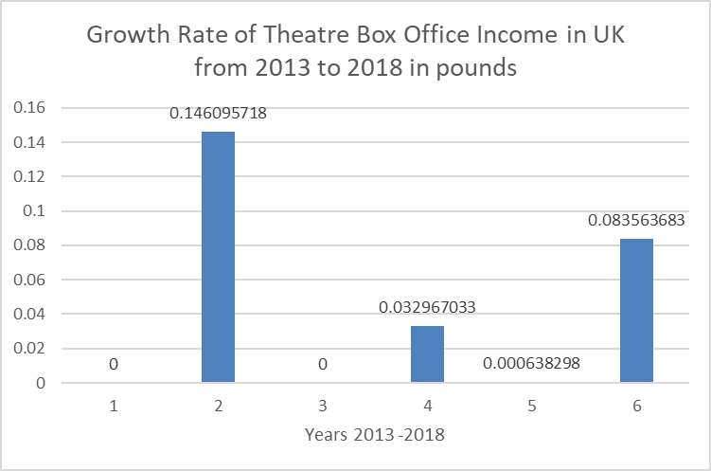
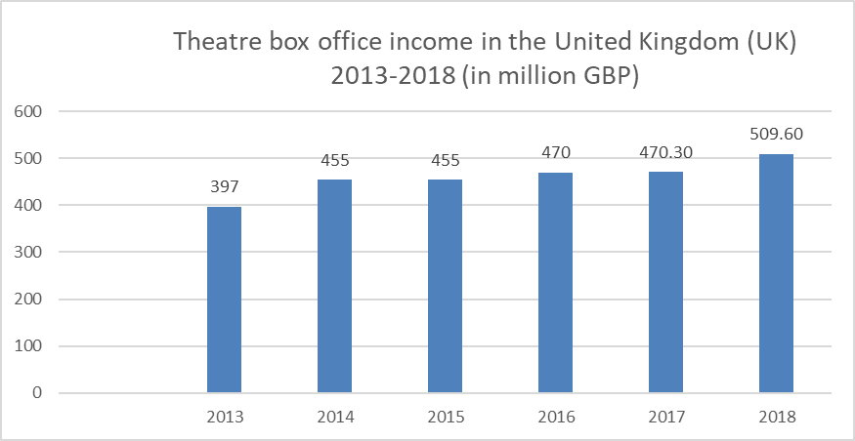
Theatre Box Office
The Gross Box income remained stable, resulting in 397 million GBP in 2013 and increasing significantly to 509 million GBP in 2018.

Slide 27
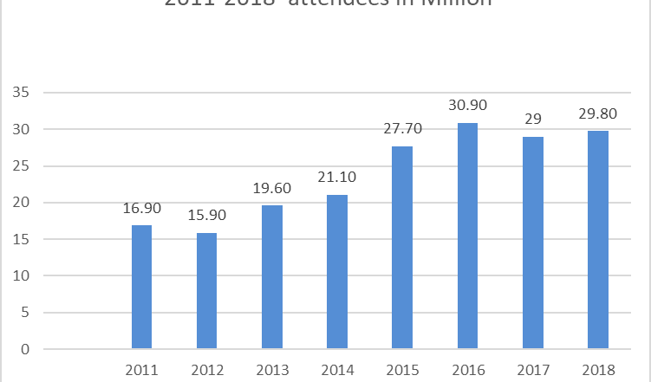
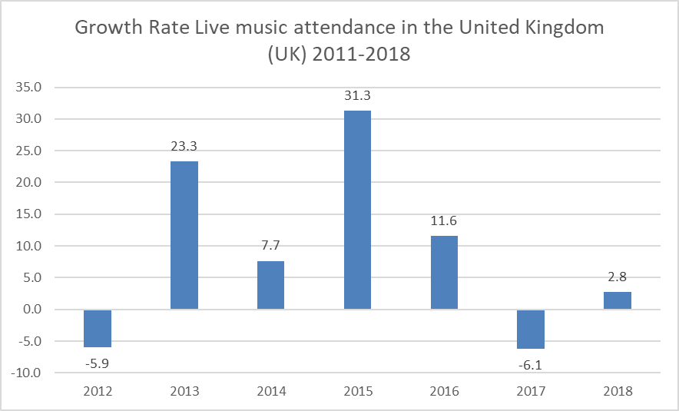
Live Music Attendance
The year 2015 witnessed the highest surge in live music attendance with an impressive 31.3% increase, creating an electrifying atmosphere for music lovers.
Strong growth momentum: Following closely, 2013 experienced the second-highest growth rate at 23.3%, demonstrating sustained interest and engagement in the UK's vibrant live music scene.
Challenging decline: Conversely, 2017 saw the lowest growth rate with a decline of -6.1%, reflecting temporary setbacks in attendance figures during that period.
Attendance peak: The highest recorded number of attendees at live music events in the UK occurred in 2016, with an estimated 30.90 million individuals, creating a vibrant and memorable experience for music enthusiasts.
Attendance low: In contrast, the lowest number of attendees was observed in 2012, with an estimated 15.90 million attendees. Despite the dip, the UK's live music scene continued to captivate audiences.

Slide 28
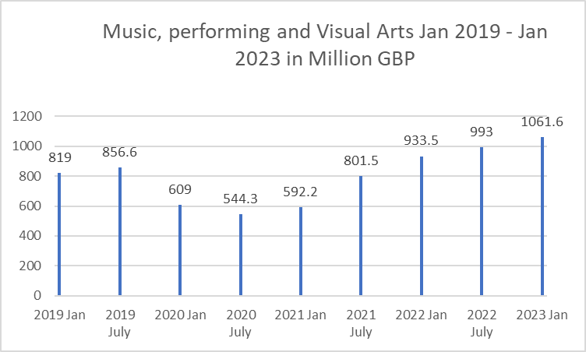
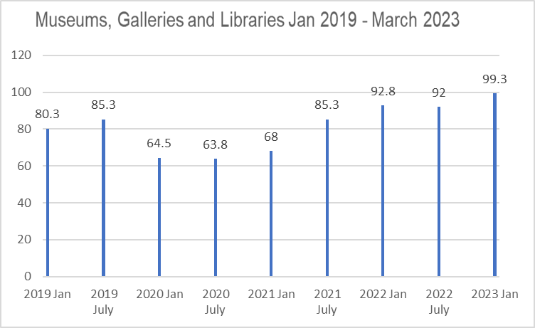
GVA
Gross Value Added represents the economic value of goods and services produced within a specific industry, sector, manufacturer, area, or region.
February 2023 peak: In February 2023, GVA reached its highest point, amounting to 100 million, indicating a robust and productive economic period.
April/May 2020 decline: The months of April and May 2020 saw the lowest GVA, estimated at 46-47 million, coinciding with the first lockdown in the UK. This period posed significant challenges to economic productivity.
Lowest GVA period: Between January 2020 and January 2021, the GVA reached its lowest point, estimated to be between 609 and 592.2 million. This period marked a challenging phase for economic productivity.

Slide 29
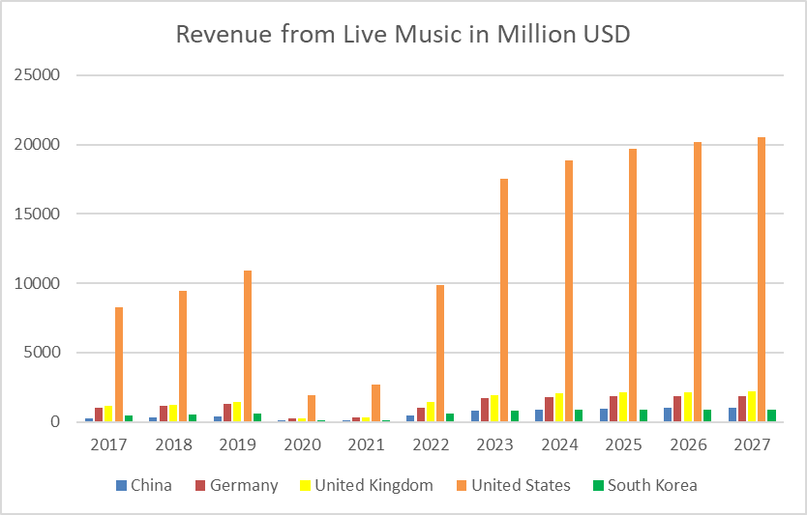
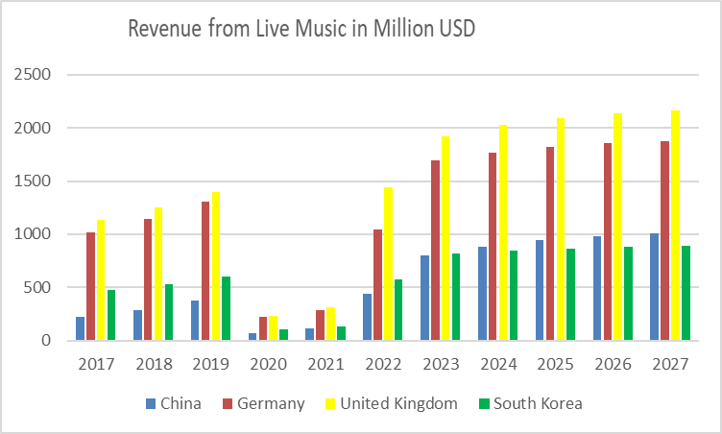
Sector Comparison

Slide 30
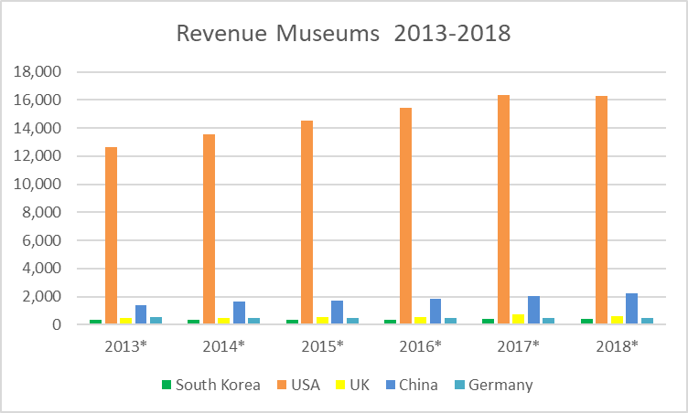
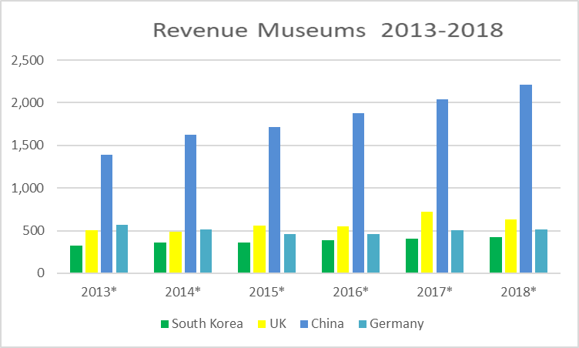
Sector Comparison

Slide 31
Design Sector

Slide 32
Apparel & Fashion sector
The UK apparel industry has shown resilience and potential for growth(revenues expected to reach 77.69 billion GBP by 2027) with a significant shift towards online sales and a positive outlook for the future.
Online dominance
Fluctuating revenue growth
Women's apparel dominance
Consumer spending resilience
Importance of adaptation
Apparel Revenue and Advertising expenditure on digital displays
Notes:
Online dominance: The industry has witnessed a substantial increase in online revenue share, surpassing offline sales, indicating the growing preference for online apparel shopping.
Fluctuating revenue growth: While the industry experienced fluctuations in revenue growth rates, the overall trend demonstrates a positive trajectory, with recovery after the decline in 2020.
Women's apparel dominance: Women's apparel remains the leading category in terms of revenue, but men's and children's apparel segments also show steady growth, presenting opportunities for expansion.
Consumer spending resilience: Consumer spending on clothing and footwear has shown overall growth, with occasional dips influenced by economic downturns and the impact of the COVID-19 pandemic.
Importance of adaptation: Businesses should adapt to changing consumer behavior and market trends, emphasizing online presence and customer-centric strategies to leverage the industry's growth potential.
The increased spending on digital static display advertising aligns with the growth of online apparel revenue seen in the overall revenue data. The shift towards online sales is likely supported by increased digital advertising efforts. crucial recommendation to emphasize is the importance of understanding and adapting to consumer preferences. The surge in online revenue share percentages, particularly in the apparel industry, indicates a clear shift towards online shopping. To capitalize on this trend, it is essential for authorities to foster and nurture the online market, paving the way for exponential growth in the apparel sector and the wider fashion industry.

Slide 33
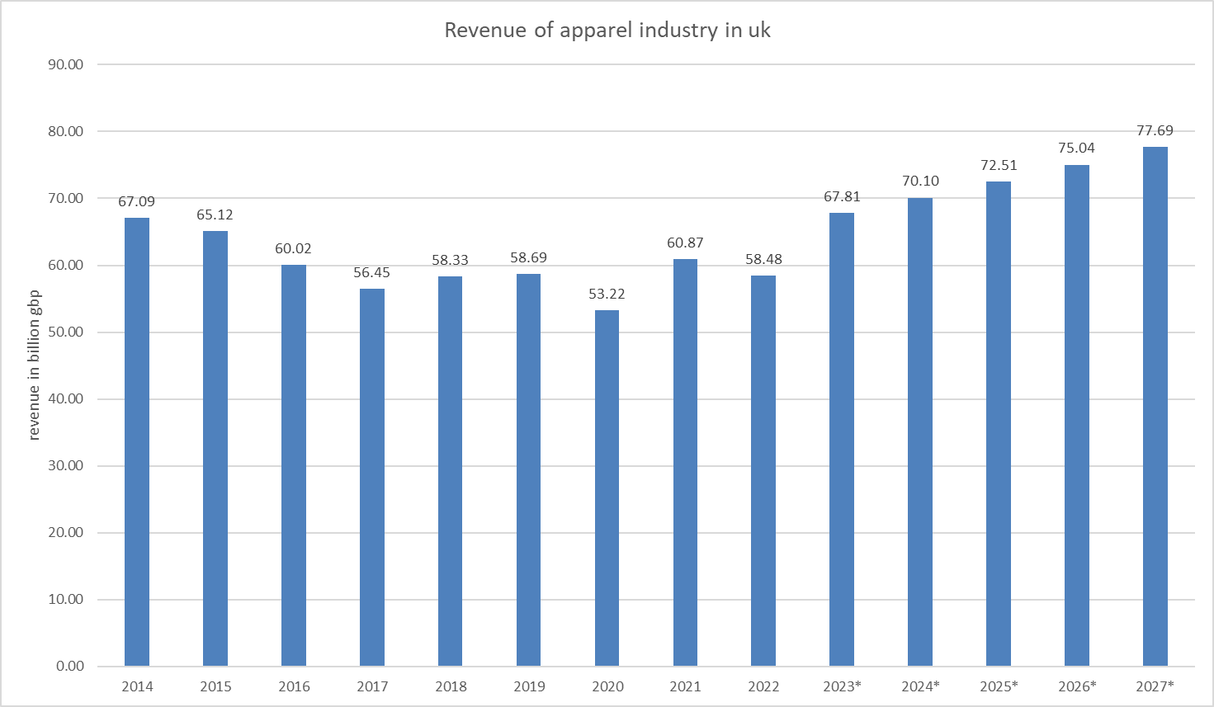
Overview of Apparel Industry
Gradual decrease in revenue over the years, reaching lowest point in 2020 at 53.22 billion GBP.
Post-2020 positive trend driven by increasing adoption of online apparel shopping.
Online platforms played a significant role in industry's resurgence.
Slight revenue decline in 2022 attributed to inflation and high living costs.
Overall growth trajectory sustained after COVID-19 pandemic.
Expectation of continued growth in the coming years.
Notes:
The apparel industry in the UK witnessed a gradual decrease in revenue over the years, reaching its lowest point in 2020 at 53.22 billion GBP.
However, a positive trend emerged post-2020, driven primarily by the increasing adoption of online apparel shopping. This shift to online platforms played a significant role in the industry's resurgence.
Notably, the industry experienced a slight decline in revenue in 2022, which can be attributed to factors such as inflation and high living costs. Nevertheless, these challenges did not hinder the overall growth trajectory of the apparel sector.
Despite the temporary setback, the apparel industry demonstrated a consistent recovery after the COVID-19 pandemic and is expected to sustain its growth momentum in the coming years.

Slide 34
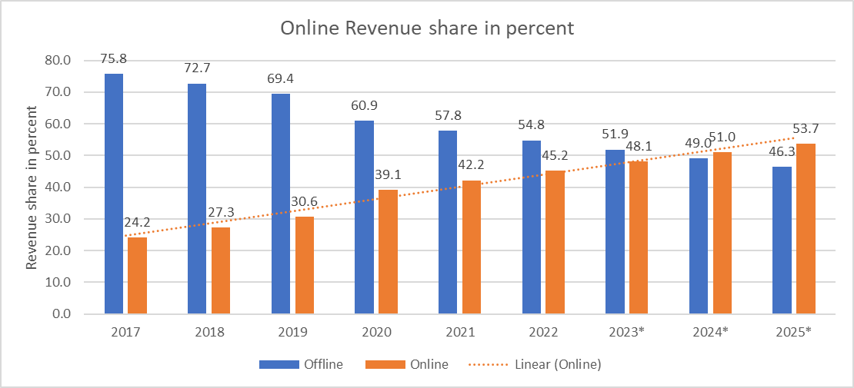
Online and Offline Revenue share in percentage
Shifting Consumer Behavior
Online Dominance
Accelerated Online Growth
Offline Revenue Decline
Future Outlook
Notes:
Shifting Consumer Behavior: There is a noticeable trend of increasing online revenue share and a corresponding decline in offline revenue share over the years. This indicates a significant shift in consumer behavior towards online shopping for apparel.
However, starting from 2020, online revenue surpasses offline revenue, indicating the increasing dominance of online channels in the apparel industry.
Online Dominance: The online revenue share has consistently been lower than offline revenue share in the earlier years (2017-2019). Accelerated Online Growth: The online revenue share experiences substantial growth from 2017 to 2021, demonstrating an upward trajectory. This suggests that consumers have been increasingly embracing online platforms for apparel purchases, and the growth is expected to continue in the coming years.
Offline Revenue Decline: Conversely, the offline revenue share experiences a decline over the years. This decline can be attributed to various factors such as the convenience of online shopping, the proliferation of e-commerce platforms, and changes in consumer preferences.
Future Outlook: Looking ahead, the data indicates a continued growth of online revenue share and a further decline in offline revenue share. By 2025, online revenue is projected to account for the majority of the apparel industry's revenue, with offline sales becoming increasingly marginalized.

Slide 35
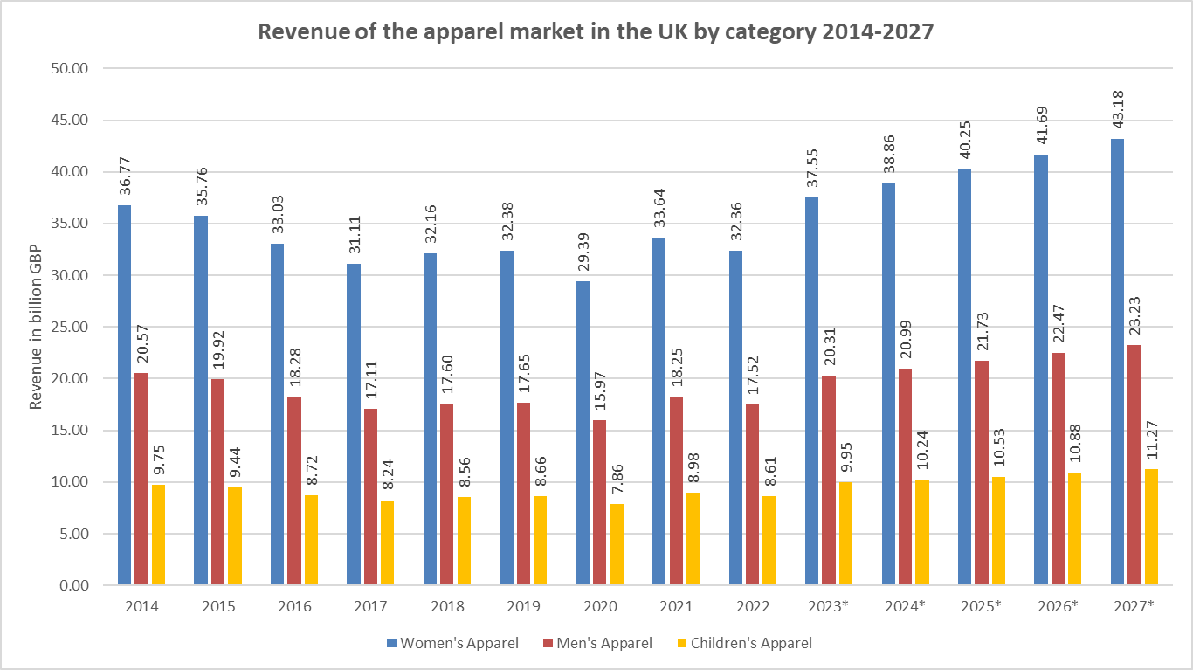
Revenue of Apparel market based on category
Notes:
Women's Apparel Dominance: Women's apparel consistently has the highest revenue among the three categories throughout the period, indicating its dominance in the UK apparel market.
Men's and Children's Apparel Growth: While women's apparel remains the leading category, both men's and children's apparel show a steady growth trend over the years, reflecting increasing consumer spending in these segments.
Dip in 2020: The year 2020 witnessed a decline in revenue across all three apparel categories, likely due to the impact of the COVID-19 pandemic, which resulted in reduced consumer spending and temporary store closures.
Recovery and Future Growth: The data suggests a recovery in revenue for all three categories in 2021 and projected growth in subsequent years (2022-2027). This indicates a positive outlook for the UK apparel market as consumer confidence and spending rebound.
Overall Market Growth: Despite fluctuations, the apparel market in the UK shows an overall growth trend, with projected revenue increases across all three categories in the forecasted years (2023-2027). This indicates a favorable market environment for the apparel industry.
The revenue of the women’s apparel segment in the UK was estimated to be 40.6 billion British pounds in 2022, which was the highest among all segments1. The revenue of this segment is projected to grow at a compound annual growth rate (CAGR) of 5% from 2022 to 2026.
The revenue of the men’s apparel segment in the UK was estimated to be 21.98 billion British pounds in 2022, which was the second highest among all segments1. The revenue of this segment is projected to grow at a CAGR of 5% from 2022 to 2026.
The revenue of the children’s apparel segment in the UK was estimated to be 10.8 billion British pounds in 2022, which was the lowest among all segments1. The revenue of this segment is projected to grow at a CAGR of 4.7% from 2022 to 2026.

Slide 36
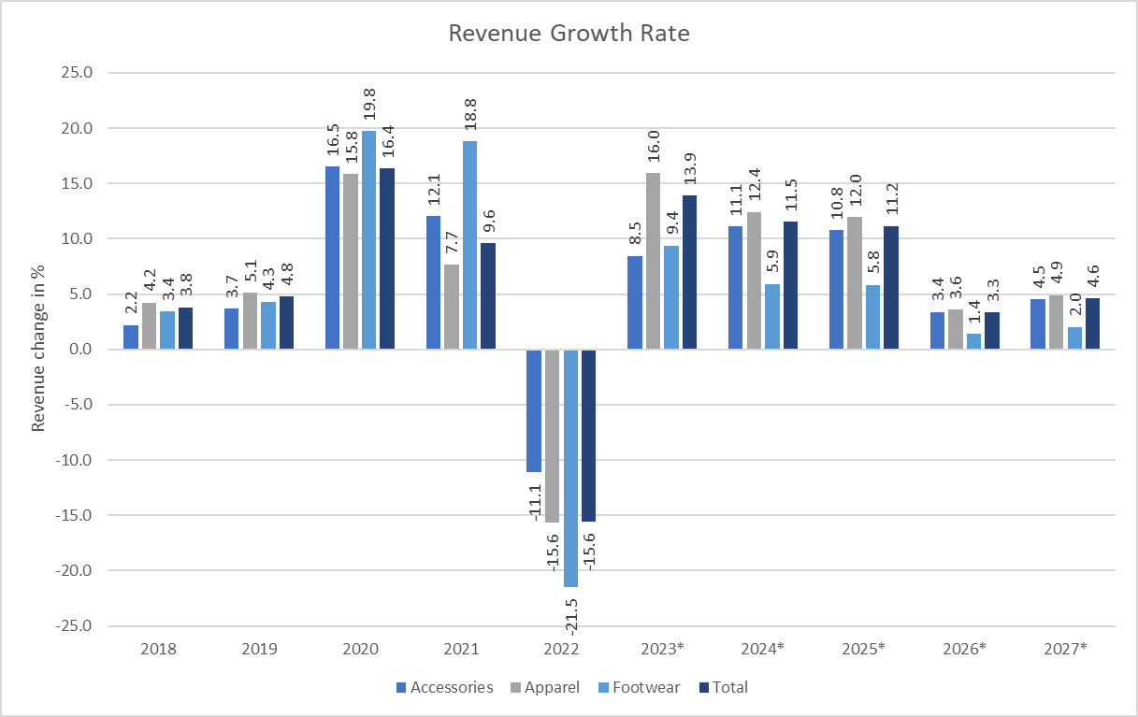
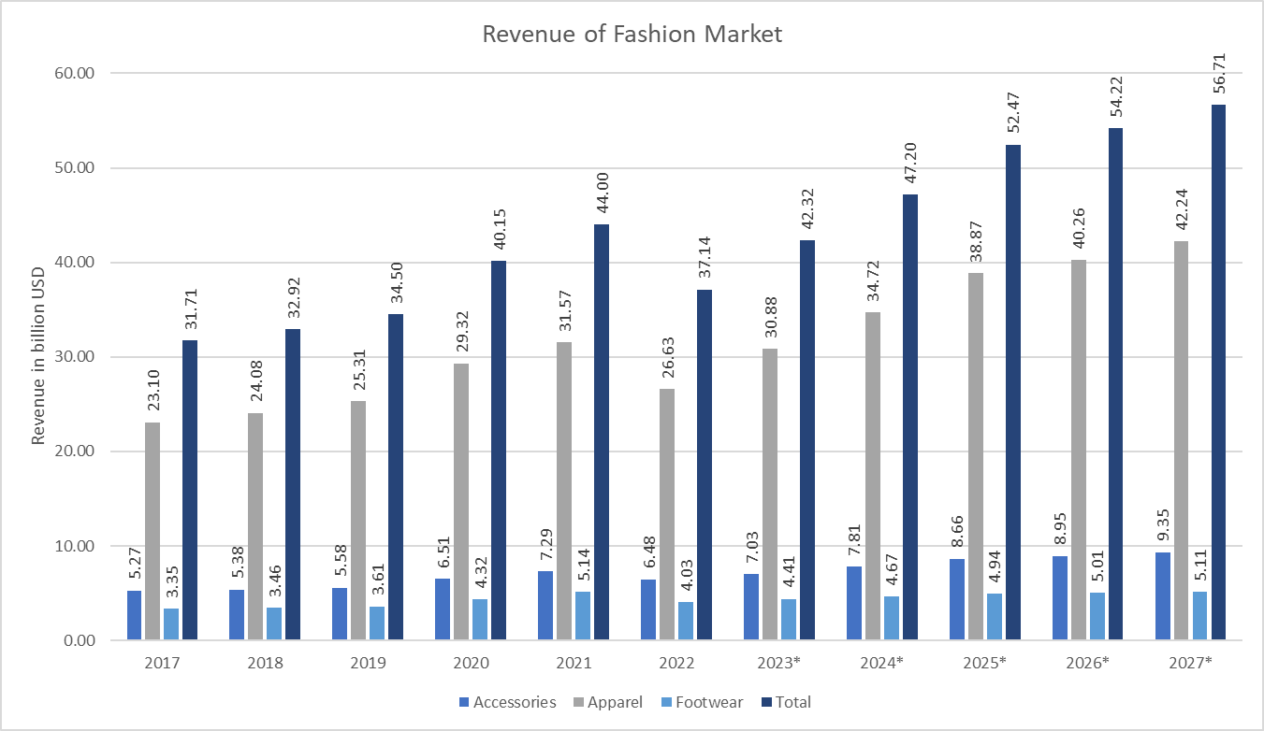
Revenue & Growth rate of Fashion market
Notes:
The negative growth rates observed indicate the impact of the COVID-19 pandemic on the fashion industry. The pandemic disrupted consumer spending patterns, supply chains, and retail operations, leading to a decline in revenue growth during those years.
Recovery and Future Growth: Both apparel market and the fashion market show a rebound in revenue growth rates in the subsequent years (2021 onwards). This suggests a recovery from the pandemic's impact and indicates a positive outlook for the industry's future growth.

Slide 37
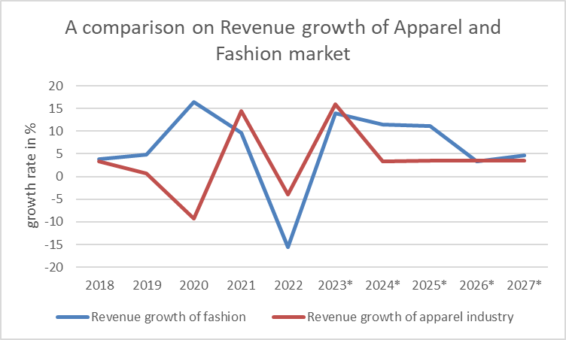
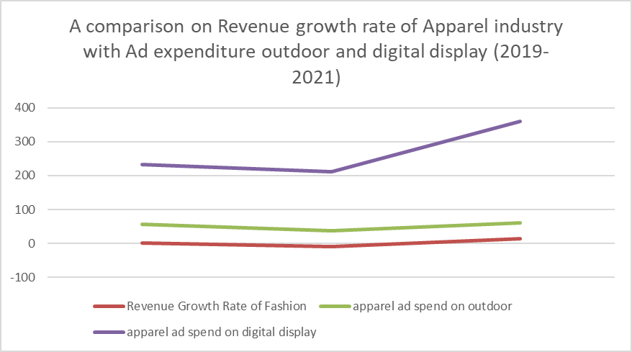
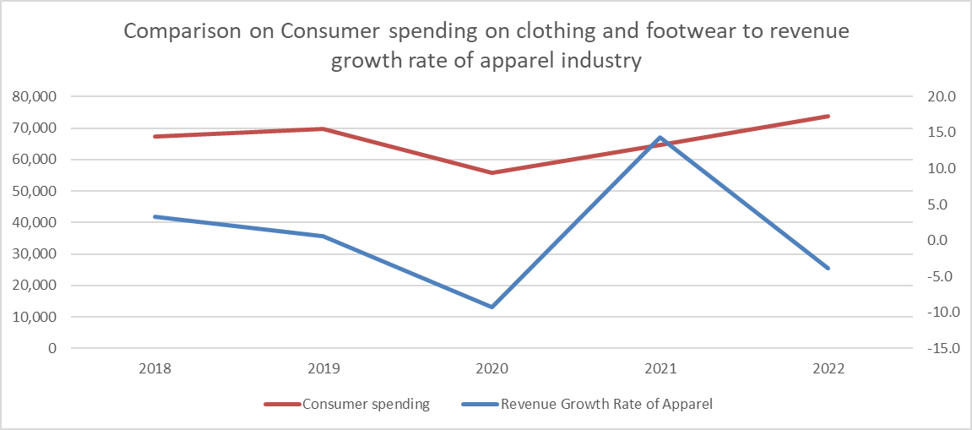
Trends in the Apparel Industry: Revenue Growth, Consumer Spending, and Advertising
Revenue Growth: Comparing apparel industry revenue with fashion market trends.
Consumer Spending: Analyzing the relationship between apparel industry revenue and consumer spending.
Advertising Impact: Examining correlation between apparel industry revenue growth and ad expenditure
Notes:
Comparison between revenue growth of apparel and fashion market
The fashion market, encompassing apparels, accessories, and footwear, often exhibited higher revenue growth compared to the apparel industry alone. This suggests that the growth of the fashion market is driven by segments beyond traditional apparel. Additionally, during the year 2020, while the apparel industry faced a significant decline, the fashion market experienced a substantial surge, indicating increased demand for accessories and footwear. Furthermore, the revenue growth rates of the fashion market and the apparel industry fluctuated over the years, highlighting the dynamic nature of the industry.
Comparison between consumer spending and revenue growth rate of apparel
An interesting insight from these figures is that there seems to be a disconnect between the revenue growth rate of the apparel industry and consumer spending on clothing and footwear. While the apparel industry experienced fluctuations in revenue growth, with both positive and negative growth rates, consumer spending on clothing and footwear generally showed a positive trend, increasing over the years (except for 2020).
Economic Factors: Despite high consumer spending, the overall economic conditions in the UK may have been unfavorable. Factors such as inflation, rising production costs, or a slowdown in GDP growth can impact businesses and consumer behavior, leading to a decline in the apparel industry.
Changing Consumer Preferences: The apparel industry is highly sensitive to changing fashion trends and consumer preferences. If there was a shift in consumer preferences towards alternative forms of clothing, such as athleisure or sustainable fashion, traditional apparel retailers may have struggled to adapt and meet the new demands.
Comparison between revenue growth and ad expenditure (both):
An interesting insight from this data is that the revenue growth rate of the apparel industry seems to have a correlation with the advertising expenditures. In 2019, when the industry experienced a modest growth rate, the ad expenditures were relatively lower compared to the following years. In 2020, when the growth rate declined significantly, the ad expenditures also decreased. However, in 2021, when the industry rebounded strongly, the ad expenditures increased significantly.
This suggests that advertising plays a role in promoting and driving revenue growth in the apparel industry. When the industry is experiencing positive growth, businesses tend to invest more in advertising, both in outdoor and digital static display formats. Conversely, during periods of declining growth, ad expenditures are likely to decrease.

Slide 38
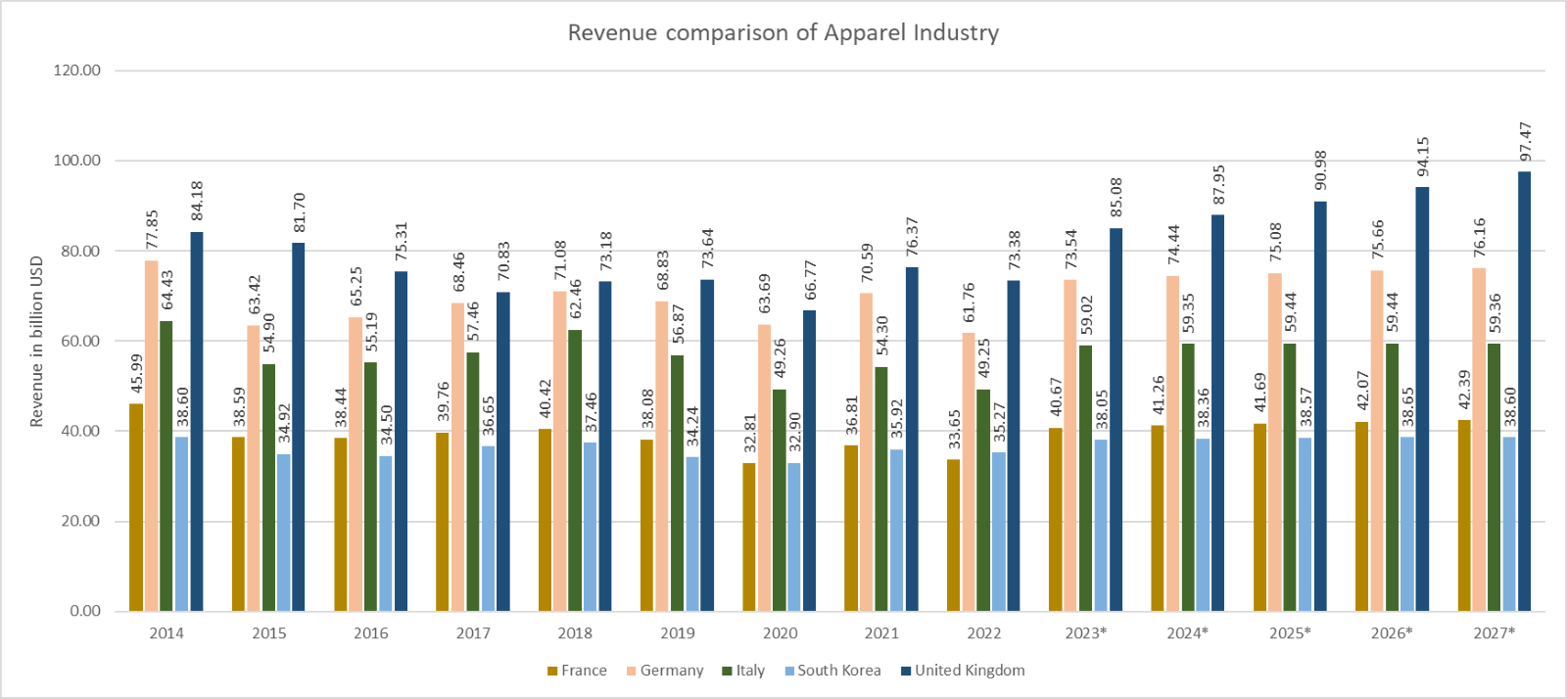
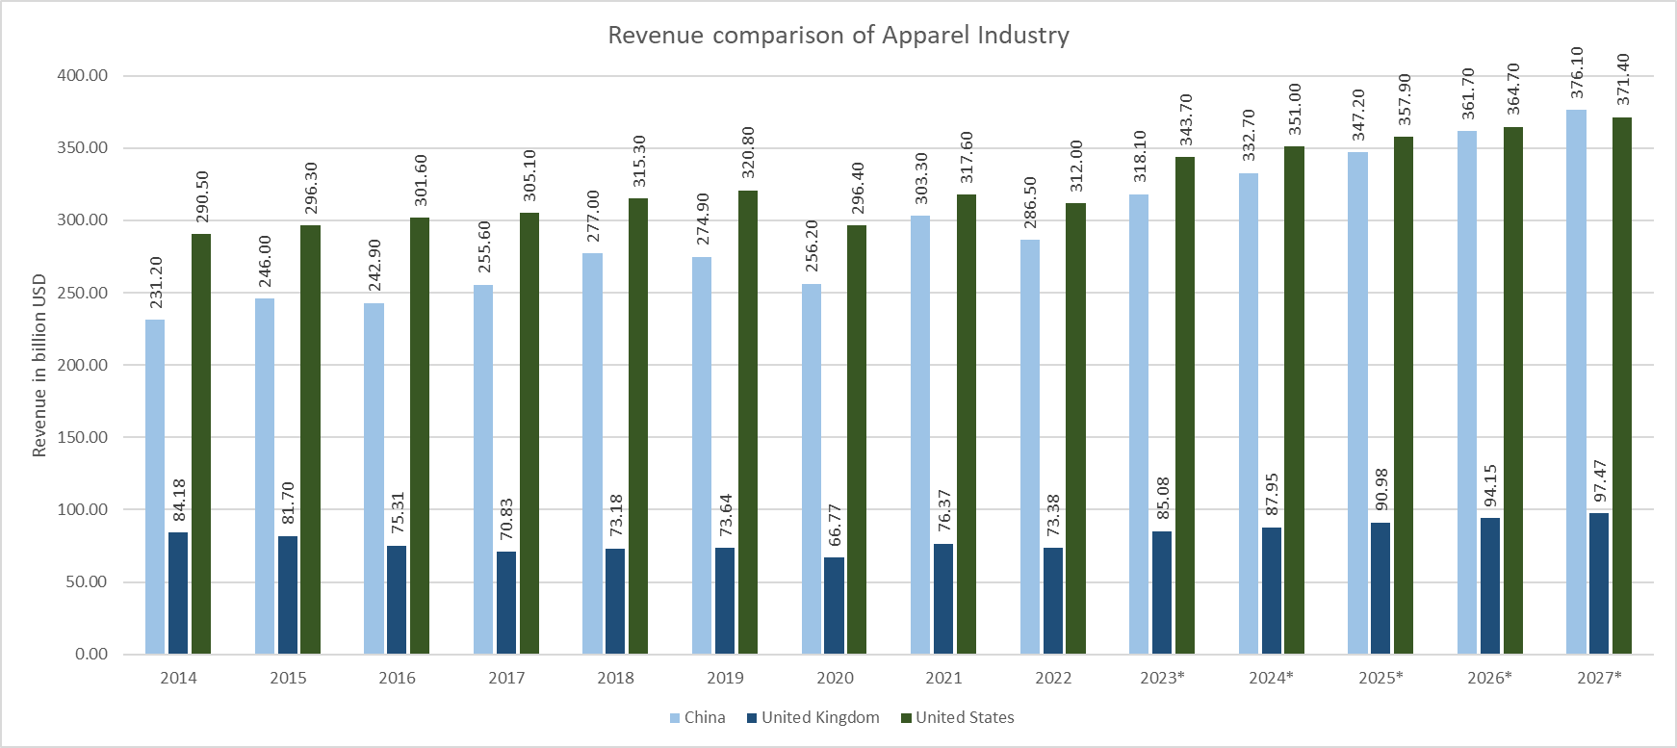
Global Comparison
Revenue comparison of UK's apparel industry with other competitors
Notes:
Global comparison
The United Kingdom has demonstrated an overall upward trend in apparel industry revenue, although there have been fluctuations along the way. And consistently maintained the highest revenue among the other listed countries.
But if you look at the bigger picture,
China has been a consistently strong performer in the apparel industry, with a steady revenue increase over the years, except for a slight dip in the last year.
The United States has consistently maintained the highest revenue among the listed countries in the apparel industry, with a notable increase over the years.

Slide 39
Architecture sector
The interior design industry in the UK is poised for strong growth, with revenue of nearly £1.5 billion in 2021-22, indicates a rebound of 10.5% from the previous year, driven by increased demand in the hospitality, residential, and commercial sectors.
The architectural activities industry is projected to reach £9.8 billion by 2027-28, growing at a compound annual rate of 3.1%.
The construction market revenue serves as the foundation for both architectural and interior design activities.
Interior design revenue closely correlates with architectural activities, as both collaborate to create visually appealing spaces.
Sustainable interior design is gaining importance, offering benefits such as improved health, cost savings, and reduced environmental impact.
Notes:
The architectural activities industry is expected to reach £9.8 billion by 2027-28, demonstrating steady growth at a compound annual rate of 3.1%. This suggests a positive outlook for architects and interior designers as they collaborate to create visually appealing spaces.
The construction market revenue serves as the foundation for both architectural and interior design activities. As the construction industry grows, the demand for architectural services and subsequently interior design services also increases. These industries are interconnected, driving each other's growth.
The interior design industry closely correlates with architectural activities, as both professions collaborate to create cohesive and visually appealing spaces. Architects provide the framework and design concepts, while interior designers focus on enhancing the aesthetics and functionality of the interior spaces.
Sustainable interior design is gaining importance in the industry. It offers a range of benefits, including improved health and well-being for occupants, cost savings through energy efficiency, and reduced environmental impact by promoting the use of renewable and eco-friendly materials. This shift towards sustainability aligns with the growing awareness of environmental responsibility and the desire for healthier living spaces.

Slide 40
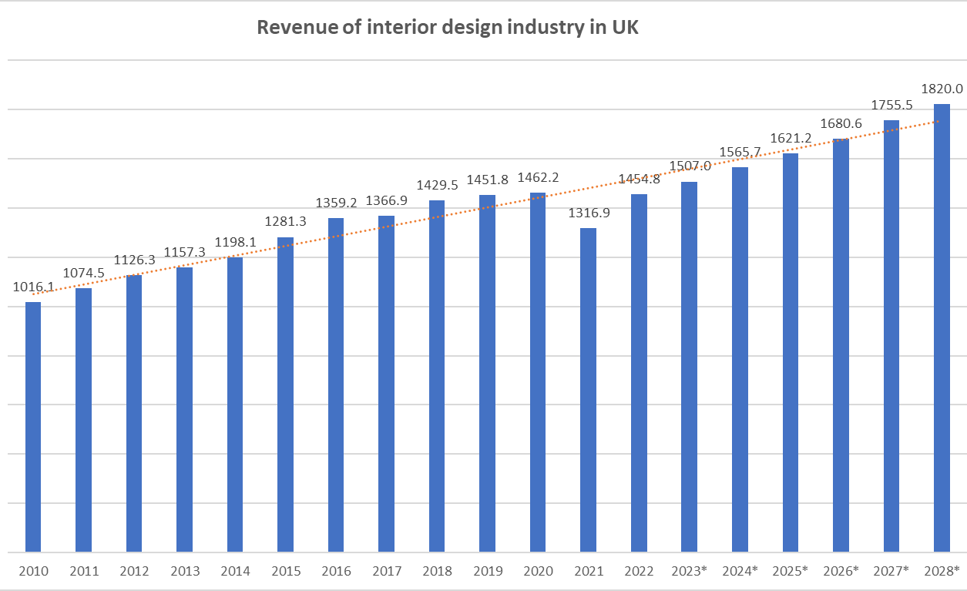
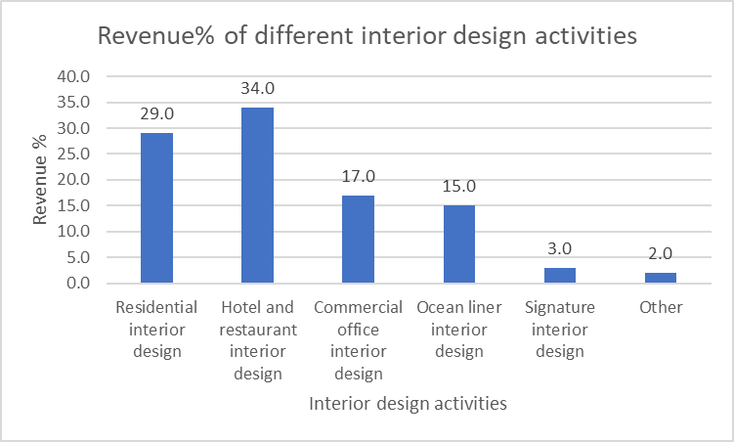
Interior Design Activities in UK
Hotel and Restaurant Interior Design
Highest revenue share at 34.0%
Amounting to £494.63 million
Significant demand in the hospitality sector
Notes:
Hotel and restaurant interior design generates the highest revenue at 34.0%, amounting to £494.63 million. This highlights the significant demand for interior design services in the hospitality sector.
Residential interior design holds the second-largest share, accounting for 29.0% of the revenue with £421.89 million. This indicates a substantial market for interior design services in the residential housing sector.
Commercial office interior design contributes 17.0% of the revenue, totaling £247.32 million. This suggests a demand for well-designed office spaces that enhance productivity and create a positive work environment.
Ocean liner interior design represents 15.0% of the revenue, generating £218.22 million. This category emphasizes the importance of interior design in the cruise industry, catering to passengers' comfort and luxury.
Signature interior design holds a 3.0% share, with £43.64 million in revenue. This likely represents specialized or high-end interior design services.
Revenue
The interior design industry experienced volatility during the COVID-19 pandemic, with a 9.9% decline in revenue in 2020-21. However, with the successful vaccine rollout and lifting of restrictions in the UK, the industry is expected to rebound strongly, with a projected 10.5% revenue increase in 2021-22, reaching nearly £1.5 billion.

Slide 41
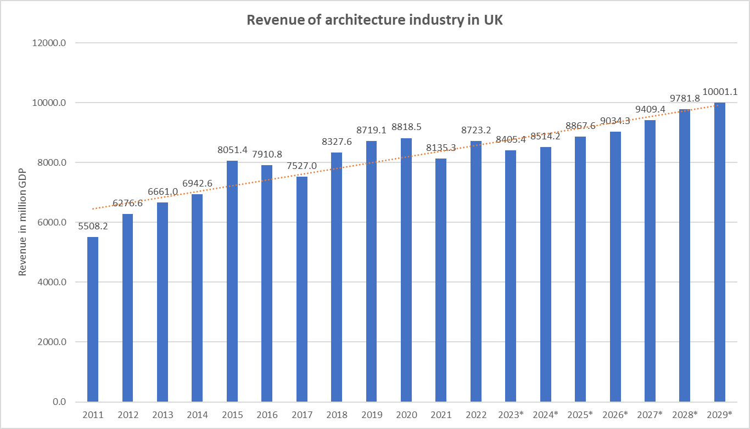
Architectural activities in UK
Revenue drop in 2020-21 due to COVID-19 and restrictions
Recovery observed as restrictions lifted, leading to rising demand
Projected revenue decline of 3.6% in 2022-23 due to economic challenges
Forecasted compound annual growth rate of 3.1% over the next five years
Notes:
The Architectural Activities industry encompasses designing, planning, and supervising the construction of buildings, urban areas, and landscapes. Demand in the industry is influenced by construction activity trends. While residential construction has been resilient due to government initiatives and consumer spending, commercial construction has faced challenges from lower business confidence and Brexit uncertainty. Intense competition from multidisciplinary firms has further impacted operators. However, overall demand has remained steady, and industry revenue is projected to increase at a compound annual rate of 0.2% over the next five years, reaching £8.4 billion by 2022-23.
The Architectural Activities industry saw a revenue drop in 2020-21 due to COVID-19 and restrictions, affecting construction activity and new work orders.
Recovery was observed as restrictions lifted, leading to rising demand from the construction sector.
However, revenue is projected to decline by 3.6% in 2022-23 due to economic challenges, including rising material prices, supply chain disruptions, and labor shortages.
Over the next five years, industry revenue is forecast to grow at a compound annual rate of 3.1% to reach £9.8 billion by 2027-28.
Factors such as lower business confidence, limited construction investment, government initiatives, technological advancements, and increased competition may impact revenue and profit in the industry.

Slide 42
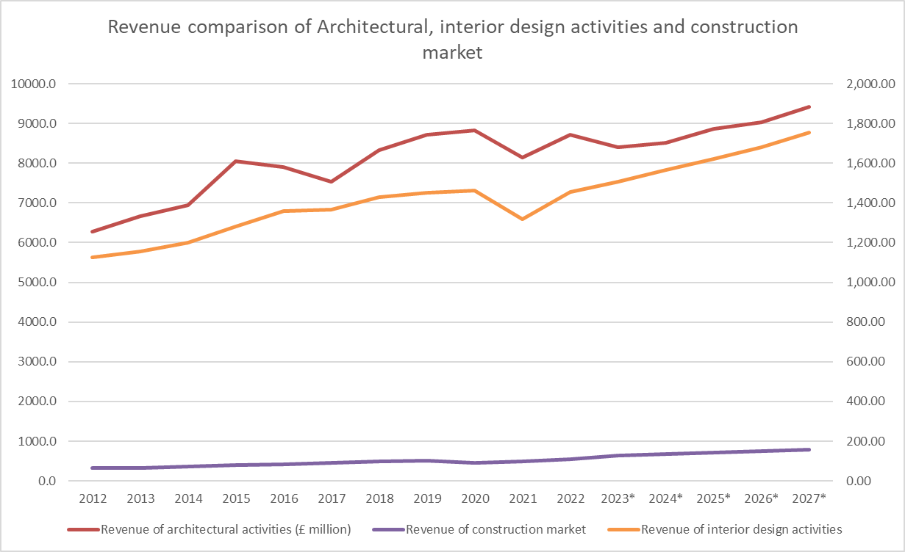
Revenue comparison
Architecture and construction revenue are interconnected, rising with increased construction activity and investment.
Interior design revenue is closely linked to architecture and construction, driven by the demand for interior enhancements in completed structures.
Architects and interior designers collaborate to create appealing spaces.
Construction projects provide opportunities for architectural and interior design activities.
Notes:
The construction market revenue serves as the foundation for both architectural and interior design activities. As the construction industry grows, the demand for architectural services and subsequently interior design services also increases. These industries are interconnected, driving each other's growth.
The interior design industry closely correlates with architectural activities, as both professions collaborate to create cohesive and visually appealing spaces. Architects provide the framework and design concepts, while interior designers focus on enhancing the aesthetics and functionality of the interior spaces.
Sustainable interior design is gaining importance in the industry. It offers a range of benefits, including improved health and well-being for occupants, cost savings through energy efficiency, and reduced environmental impact by promoting the use of renewable and eco-friendly materials. This shift towards sustainability aligns with the growing awareness of environmental responsibility and the desire for healthier living spaces.
Architectural activities revenue and construction market revenue generally move in the same direction, reflecting their interdependence. As construction activity and investment increase, the demand for architectural services also tends to rise.
Interior design activities revenue is closely tied to both architectural activities and the construction market. The growth in construction projects and architectural designs drives the demand for interior design services, as completed structures require interior enhancements.
Architecture activities revenue and interior design activities revenue are closely linked, as architects collaborate with interior designers during the design process to ensure cohesive and visually appealing spaces.
The revenue of the construction market serves as a foundation for both architectural and interior design activities, as construction projects provide opportunities for design and implementation.

Slide 43
Growth and Correlation: Digital Console and Online Gaming Industry
The digital console and online gaming sector in the UK has experienced steady growth, with consumer spending increasing from £891 million in 2013 to £2,640 million in 2022.
The COVID-19 pandemic had a significant impact, leading to a spike in spending in 2020, and the industry has shown resilience and continued growth.
Digital Transformation
Interplay between Digital Video Game Sales Revenue and Consumer Spending in the Gaming Sector
Notes:
Consistent Growth: Consumer spending on digital console and online games in the UK has shown consistent growth, indicating a thriving market. Revenue increased from £891 million in 2013 to £2,640 million in 2022.
COVID-19 Impact: The pandemic resulted in increased demand for gaming as people sought entertainment options at home.
Digital Transformation: Advancements in technology, the availability of online gaming platforms, and the popularity of multiplayer and competitive gaming have contributed to the growing consumer demand for digital console and online games.
The correlation between digital video game sales revenue and consumer spending on digital console and online games suggests that changes in video game sales revenue can be indicative of changes in consumer spending patterns.
The video game industry encompasses various platforms, including consoles, PC gaming, mobile gaming, and online platforms. Revenue from video game sales can come from multiple sources such as game sales, in-game purchases, subscriptions, downloadable content, and more. The correlation between digital video games sales revenue and consumer spending on digital console and online games does not imply that consoles are the sole contributor to the revenue of video games.
This correlation suggests that there is a connection between the revenue generated from digital video game sales and consumer spending on digital console and online games in the United Kingdom. It implies that changes in digital video games sales revenue can be used as an indicator or predictor of changes in consumer spending on digital console and online games.
Spending in 2020 reached £2,399 million, showcasing the impact of lockdowns and restrictions on the industry.
Recovery and Growth: After a slight dip in spending in 2021, the industry rebounded in 2022, reaching a new peak of £2,640 million. This demonstrates the industry's resilience and the sustained growth of consumer interest in digital console and online games.

Slide 44
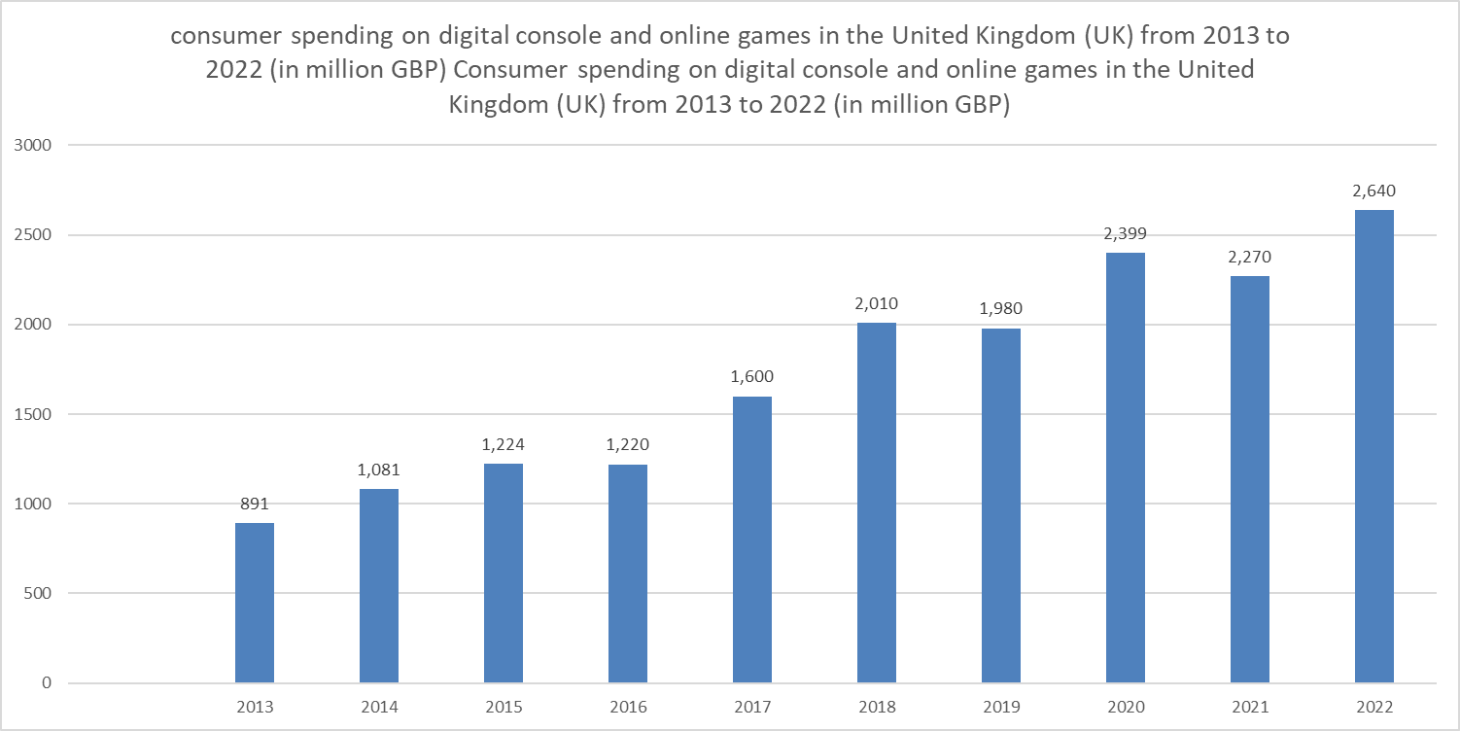
Digital console and online games
Steady growth: UK consumer spending on digital console and online games increased from £891 million in 2013 to £2,640 million in 2022.
Fluctuations: Some years showed fluctuations, but overall, the trend has been upward.
COVID-19 impact: 2020 saw a spike in spending (£2,399 million) due to increased gaming demand during lockdowns.
Recovery and growth: Spending rebounded in 2022, reaching a new peak of £2,640 million.
Increased consumer demand: Growing interest in digital console and online games driven by technology advancements and multiplayer gaming popularity.
Notes:
Steady Growth: Over the nine-year period, consumer spending on digital console and online games in the UK has shown consistent growth. The spending has increased from £891 million in 2013 to £2,640 million in 2022.
Fluctuations: While there is an overall upward trend, there are certain years where spending has fluctuated. For example, in 2015, there was a significant increase in spending from the previous year, followed by relatively stable spending in the subsequent years.
COVID-19 Impact: The year 2020 saw a notable spike in spending, reaching £2,399 million. This increase can be attributed to the COVID-19 pandemic, which led to lockdowns and increased demand for gaming as people sought entertainment options at home.
Recovery and Growth: Although there was a slight dip in spending in 2021 compared to the previous year, the spending rebounded in 2022, reaching a new peak of £2,640 million. This indicates a recovery from the pandemic's impact and continued growth in the industry.
Increased Consumer Demand: The consistent growth in spending suggests a growing consumer interest in digital console and online games in the UK. This can be attributed to factors such as advancements in technology, increasing availability of online gaming platforms, and the popularity of multiplayer and competitive gaming.

Slide 45
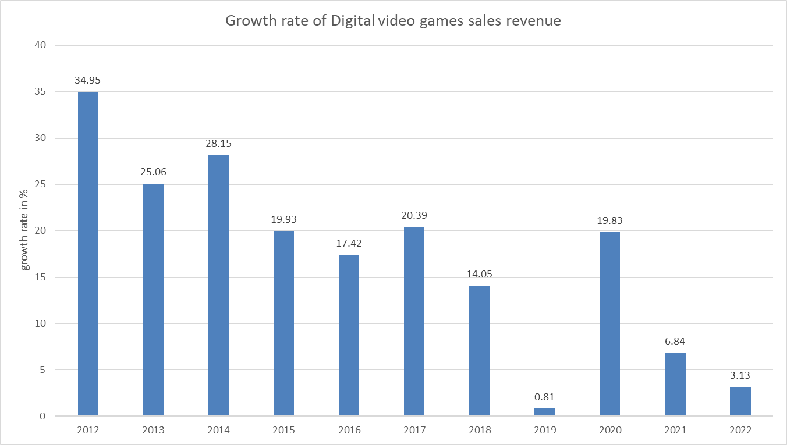
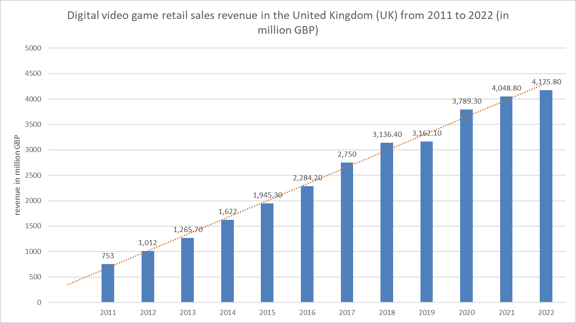
Video Games
Consistent revenue growth: UK digital game retail sales revenue increased from £1,012 million in 2012 to £4,175.80 million in 2022.
Steady growth rate: Average growth rate of approximately 16% with fluctuations.
Impact of digital transformation: Growing popularity of digital game purchases due to online platforms and convenience.
Moderate recent growth: Market has matured, resulting in slower growth compared to earlier years.
Resilience during COVID-19: Revenue continued to grow (6.84% in 2021) despite pandemic challenges.
Notes:
Consistent Revenue Growth: The revenue from digital video game retail sales in the UK has shown consistent growth over the years, indicating a thriving market for digital games. The revenue increased from £1,012 million in 2012 to £4,175.80 million in 2022.
Steady Growth Rate: The growth rate of revenue fluctuates from year to year, but overall, it has been positive throughout the period. The growth rate ranges from 0.81% in 2019 to 34.95% in 2012, with an average growth rate of approximately 16%.
Impact of Digital Transformation: The data highlights the increasing popularity and adoption of digital game purchases in the UK. This trend can be attributed to the growth of online gaming platforms, digital distribution platforms, and the convenience of purchasing and accessing games digitally.
Moderate Growth in Recent Years: In recent years, the revenue growth rate has stabilized at a moderate level. This suggests a matured market and a slower growth pace compared to earlier years when the digital game market was rapidly expanding.
Resilience During COVID-19: Despite the challenges posed by the COVID-19 pandemic, the digital video game retail sales revenue in the UK continued to grow. The revenue increased by 6.84% in 2021, indicating the resilience of the gaming industry and the increased demand for digital entertainment during periods of lockdowns and social distancing measures.

Slide 46
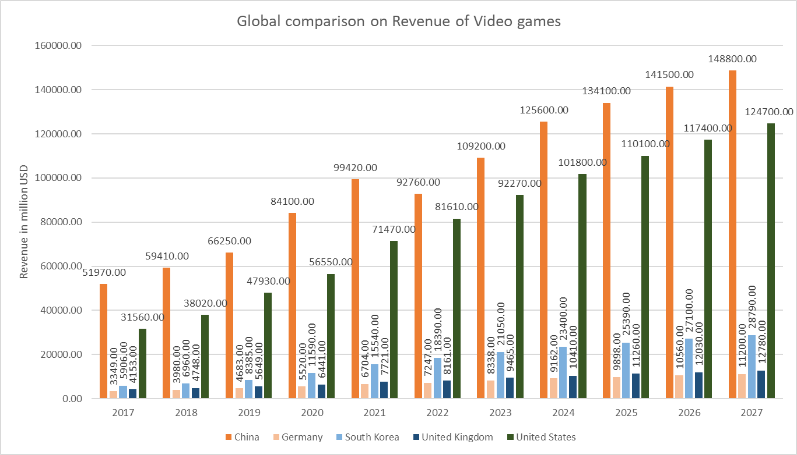
Global Comparison

Slide 47
Recommendations
Access to proprietary data would have enabled comprehensive market research and help uncover deeper insights for a more thorough understanding of the industry landscape.
Allocate Sufficient Time for Data Collection and Analysis: Recommend extending the timeline to allow for thorough data collection, exploratory data analysis (EDA), and the development of a user interactive dashboard, enabling comprehensive insights and enhanced data visualization in the market study.
Collaborate for a Data-Driven Future: Encourage collaboration and data sharing among stakeholders, such as government bodies, industry organizations, and researchers, to overcome data challenges and unlock comprehensive insights in the creative industries.
Notes:
Throughout my exploration, I sought to define the creative industries and gain a comprehensive understanding of each sector. It involved meticulous research, searching for suitable core and supportive data to analyze the trendlines and other influential factors. However, due to the limitations of accessing only publicly available datasets, obtaining relevant and detailed data proved to be challenging. For instance, the dataset concerning construction market revenue appeared limited, with a lack of information on the metrics adopted for calculation. A more comprehensive and accurate dataset would have facilitated a more profound analysis of the creative industries in the UK.

